Slide 1

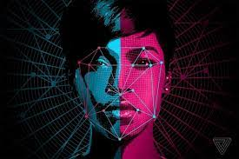
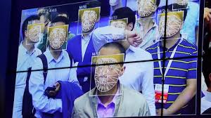

Slide 2







MEMBER
GROUP 3
GREAT TEACHER INSTRUCTOR:
TRẦN THÀNH CÔNG
NGUYỄN HOÀNG HẢI
EXPLAIN
CODE
IDEA
FIX PROJECT
MAI VĂN QUYỀN
WORD
SEARCH INF
DEMO AND COMMENT
NGÔ THÀNH NHÂN
ALGORITHM
POWERPOINT
FINDING FAULT
DƯƠNG QUỐC TRÍ
PRESENTATION
SEARCH INF
SUMMARY OF COMMENTS AND EXPLANATION

Slide 3

CONTENT
GROUP 3
Introduction
Segmentation Methods
Face Detection using Haar cascades
Human Skin Color Based Face Detection
Face Recognition
Conclusions
References

Slide 4

INTRODUCTION
GROUP 3
Face detection is the process of locating human faces in still photographs and videos.
Face detection is a one kind of special application of image segmentation.
Here, we have to segment the image or video frame and then have to identify the segment or region which contains a human face.
Face detection is a necessary preprocessing step for any automatic face recognition or face expression analyzer system.

Slide 5
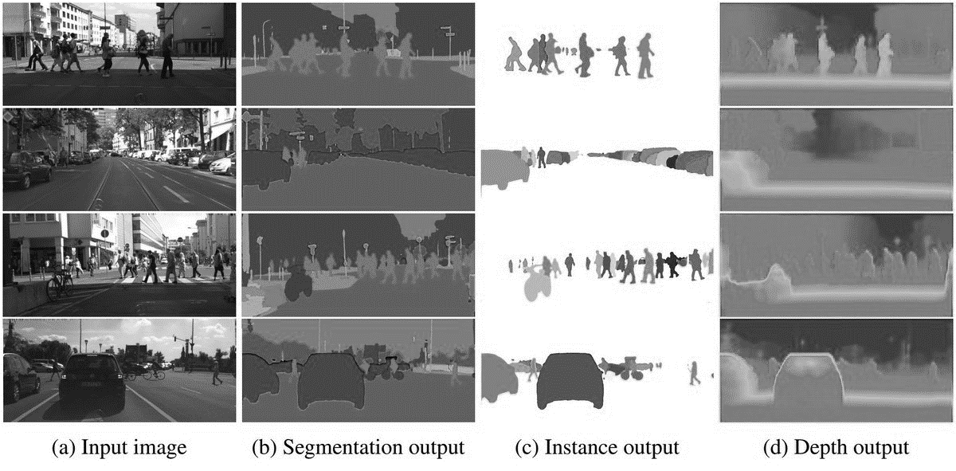
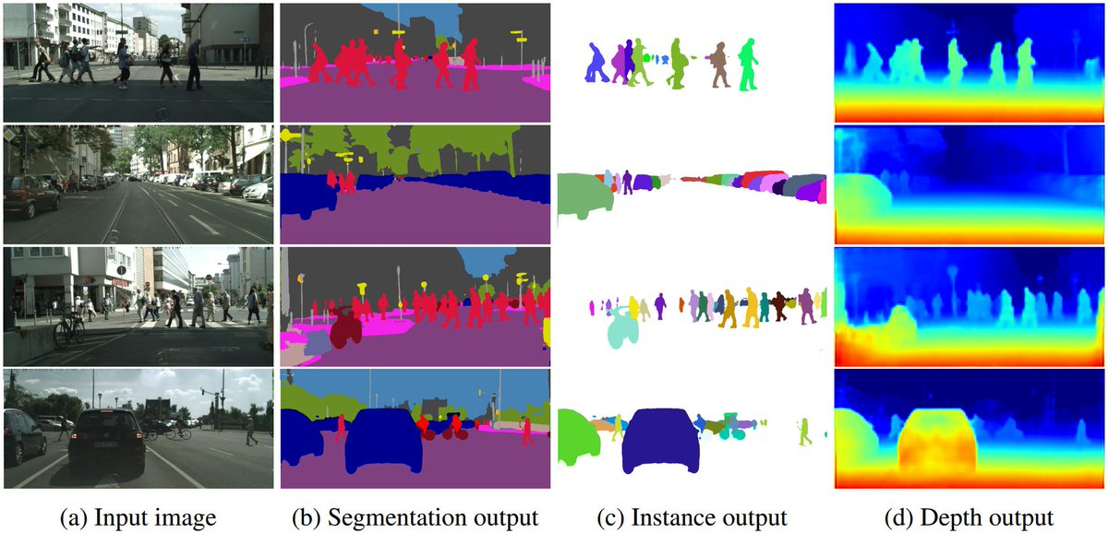
IMAGE
SEGMENTATION
GROUP 3
An image may be defined as a two dimensional function, f (x, y), where x and y are spatial (plane) coordinates, and the amplitude of f at any pair of coordinates (x, y) is called the intensity or gray level of the image at that point.
The process of partitioning an image into meaningful groups of connected pixels is called segmentation.
Image segmentation is one of the most important steps leading to the analysis of processed image data.
Types : There are 2 types of Image Segmentation.
1. Complete Segmentation 2. Partial Segmentation
1.Complete Segmentation:-Set of disjoint regions uniquely corresponding with objects in the input image.
2. Partial Segmentation:-Regions do not correspond directly with image objects.

Slide 6
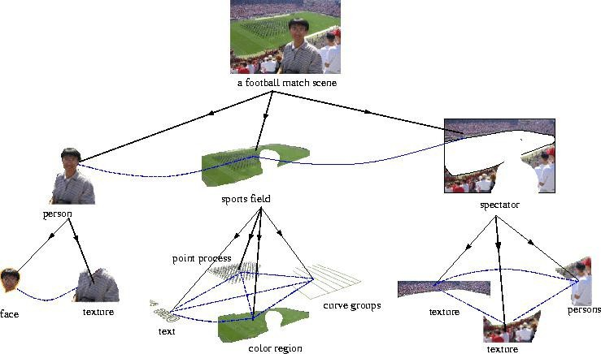
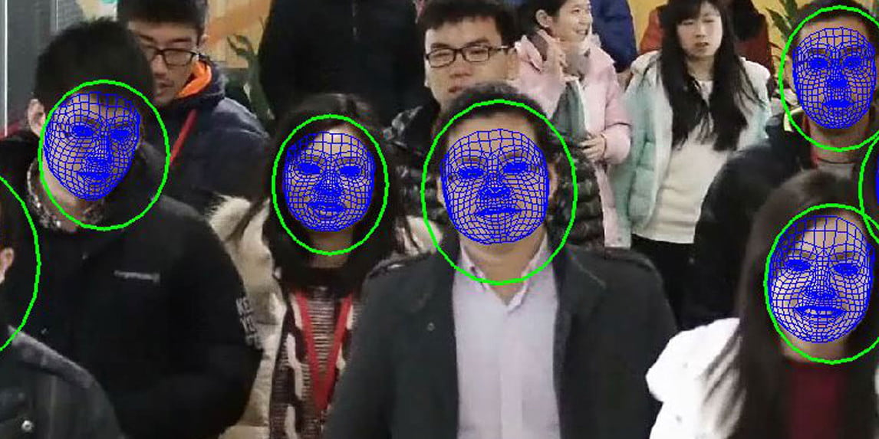
IMAGE
SEGMENTATION
GROUP 3
The above figure clarifies the process of image segmentation.Here,afootball match scene image is segmented. Two level of segmentation are displayed. The segmentation process extracts the regions of an image which contains the real word objects and makes the image.

Slide 7
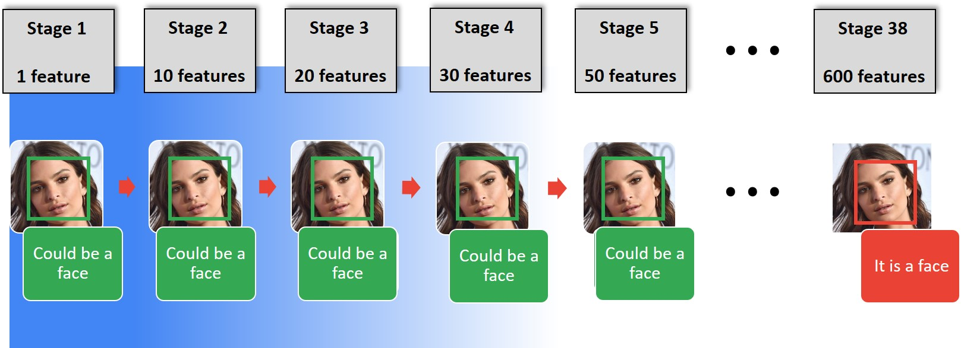
FACE DETECTION
USING
HAAR CASCADES
GROUP 3
Based:
Devised by Paul Viola and Micheal Jones in 2001.
Robust and very quick.
15 times quicker than any technique at the time of release..
Could be operated in real-time
(95% accuracy at round 17 fps)
Feature extraction and feature evaluation
With a new image representation their calculation is very fast
Classifier training and feature selection using method called Adaboost
A degenerate decision tree of classifier is formed.

Slide 8
FACE DETECTION
USING
HAAR CASCADES
GROUP 3
2. Features
Four basic types:
They are easy to calculate.
The white areas are subtracted from the blacks ones
Edge Feature
Line Feature

Slide 9

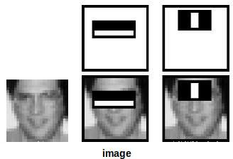
FACE DETECTION
USING
HAAR CASCADES
GROUP 3
3.
Features Extraction

Slide 10
FACE DETECTION
USING
HAAR CASCADES
GROUP 3
Variations in pose
Illumination Changes
Camera Parameters
Occlusion
Head positions, frontal view, profile view and head tilt, facial expressions.
Light direction and intensity changes, cluttered background, low quality images.
Resolution, color balance etc.
Glasses, facial hair and makeup.
4. Challenges in Haar cascades

Slide 11
FACE DETECTION
USING
HAAR CASCADES
GROUP 3
Advantages:
High detection accuracy.
Low false positive rate.
5.
Advantage
and
disadvantages
Disadvantages:
Computationally complex and slow.
Longer training time.
Less accurate on black faces.
Limitation in difficult lightening conditions.
Less robust to occlusion/obstacle.

Slide 12
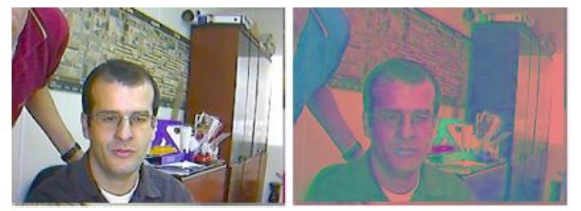
GROUP 3
HUMAN SKIN COLOR
BASED FACEDETECTION
The process for face detection based on human skin color involves two stages.
1. Filtering, to find human skin colored regions from an input image.
In this first stage, the image containing RGB color format is transformed to YCbCr color format. For this conversion we can use the following formulae.
Y = (0.299) R + (0.587) G + (0.114) B
Cb = (-0.169) R - (0.332) G + (0.500) B
Cr = (0.500) R + (-0.419) G + (-0.081) B
A
Original image
B
YCbCr image

Slide 13
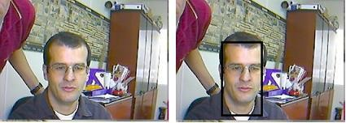
GROUP 3
HUMAN SKIN COLOR
BASED FACEDETECTION
The process for face detection based on human skin color involves two stages.
2. Finding out region containing facial part.
B
Face Detected image
(shown using Rectangle)
A
Original image

Slide 14
GROUP 3
ADVANTAGES AND DISADVANTAGES
Advantages:
This method does not need time-consuming process to train any neural network or classifier
Also there is no need of computing distance measures between every possible region in the
This method is orientation independent.
The public are already aware of its
capture and use for identity
Verification
purposes.
Disadvantages:
Face Detection is affected by changes in lighting, the person’s hair, the age, and if the person wear glasses.
Requires camera equipment for user identification;
thus, it is not likely to become popular
until most PCs include
cameras as standard
equipment.

Slide 15
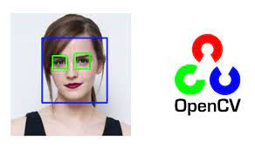
GROUP 3
OPEN CV
Open Source Computer Vision
Features:
a library of programming functions mainly aimed at real-time computer vision.
Originally developed by Intel.
The library is cross-platform free for use under the
open- source BSD license.
OpenCV supports the deep learning frameworks TensorFlow, Torch/PyTorch and Caffe.
Applications are object, face and gesture recognition, lip reading, Human- Computer Interaction (HCI), Motion Tracking, Motion understanding, and Mobile Robotics.

Slide 16

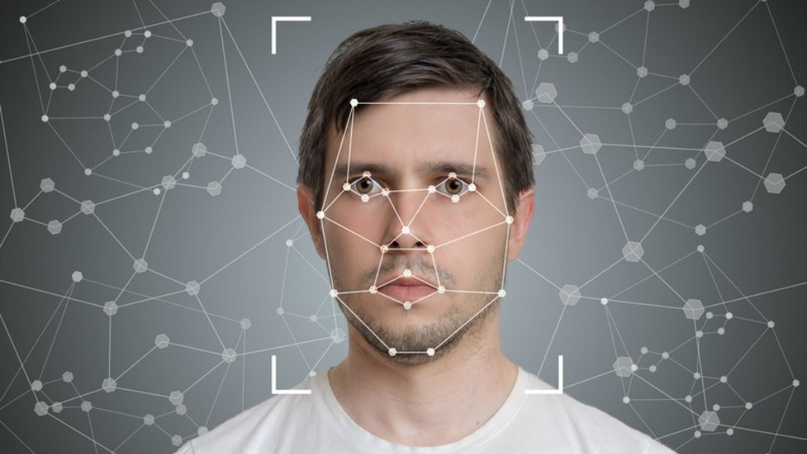

Facial recognition software is based on the ability to first recognize faces, which is a technological feat in itself. If you look at the mirror, you can see that your face has certain distinguishable landmarks. These are the peaks and valleys that make up the different facial features.
VISIONICS defines these landmarks as nodal points. There are about 80 nodal points on a human face.

Slide 17


Normalization-The image of the head is scaled and rotated so that it can be registered and mapped into an appropriate size and pose. Normalization is performed regardless of the head's location and distance from the camera. Light does not impact the normalization process.
Representation-The system translates the facial data into a unique code. This coding process allows for easier comparison of the newly acquired facial data to stored facial data.
Matching- The newly acquired facial data is compared to the stored data and (ideally) linked to at least one stored facial representation.

Slide 18
The system maps the face and creates a faceprint, a unique numerical code for that face. Once the system has stored a faceprint, it can compare it to the thousands or millions of faceprints stored in a database.
Each faceprint is stored as an 84-byte file

Slide 19
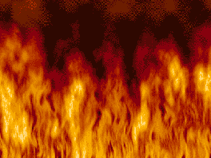

It has the ability to leverage existing image acquisition equipment.
It can search against static images such as driver’s license photographs.
It is the only biometric able to operate without user cooperation.

Slide 20



Changes in acquisition environment reduce matching accuracy.
Changes in physiological characteristics reduce matching accuracy.
It has the potential for privacy abuse due
To noncooperative enrollment and identification capabilities.

Slide 21

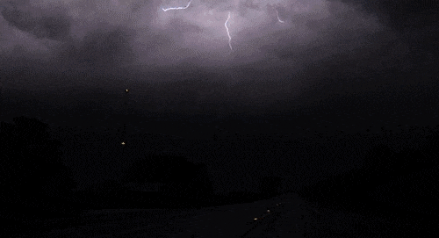
Security/Counterterrorism. Access control, comparing surveillance images to Know terrorist.
Day Care: Verify identity of individuals picking up the children.
Residential Security: Alert homeowners of approaching personnel
Voter verification: Where eligible politicians are required to verify their identity during a voting process this is intended to stop voting where the vote may not go as expected.
Banking using ATM: The software is able to quickly verify a customer’s face.

Slide 22
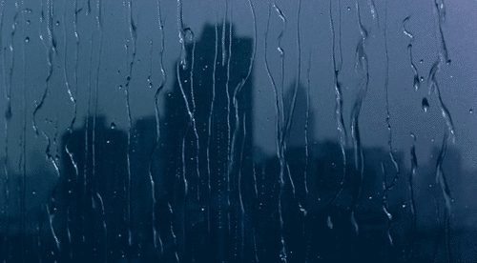

Factors such as environmental changes and mild changes in appearance impact the technology to a greater degree than many expect.
For implementations where the biometric system must verify and identify users reliably over time, facial scan can be a very difficult, but not impossible, technology to implement successfully.

Slide 23
GROUP 3
REFERENCES
[B1]: Digital Image Processing, by Rafael Gonzalez, Richard Woods
[B2]: Image Processing, Analysis, and Machine Vision, by Milan Sonka, Vaclav Hlavac, Roger Boyle
[B3]: A Guide to MATLAB, by Brian R. Hunt, Ronald L. Lips man, Jonathan M. Rosenberg
Web-sites:
[W1]: https://medium.com/@ageitgey/machine-learning-is-fun-part-3-deep-learning-and-convolutional-neural-networks-f40359318721
[W2]: https://medium.com/analytics-vidhya/haar-cascades-explained-38210e57970d
[A] Wiskott, et al. (1997) “Face recognization by elastic bunch graph matching. IEEE Trans. Patt. Anal. Mach. Intel. 19, 775-779.

Slide 24
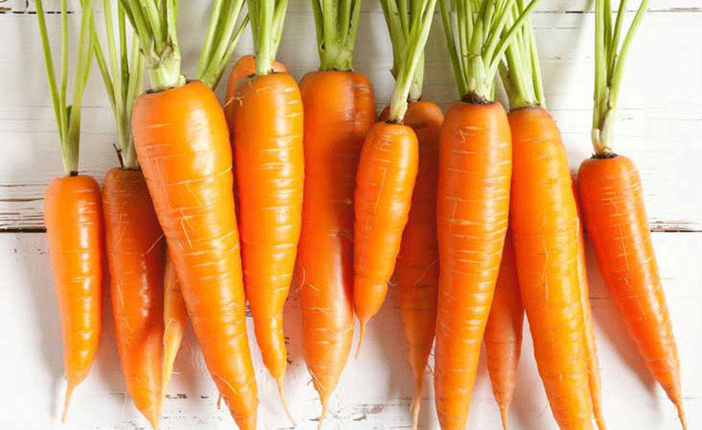

GROUP III
QUESTION

Slide 25

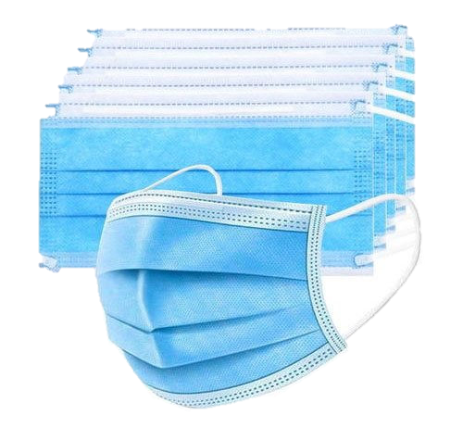
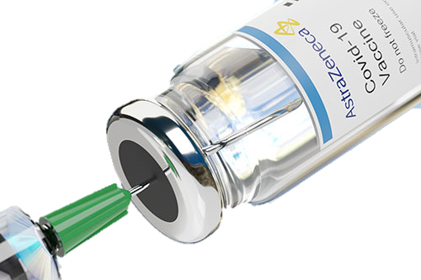
GROUP 3
THANK
FOF
LISTENNING

